Slide 1
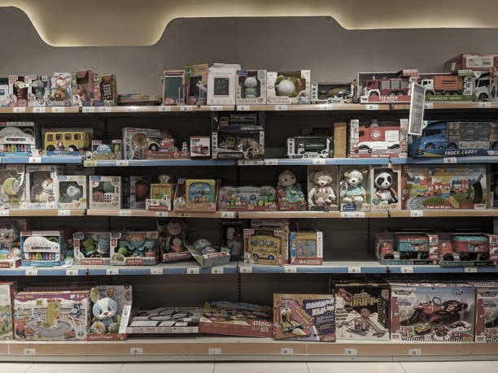
SQL PROJECT
MAVEN TOYS STORE
ANALYSIS
- Odufuwa Sayo

Slide 2
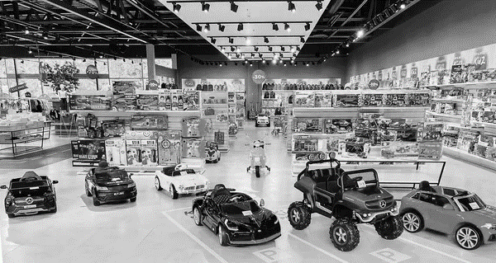
Maven Toys Store Analysis
OBJECTIVE
The primary objective of the maven toys store is to achieve sustainable business growth while addressing existing challenges.
We need to examine the dataset with SQL and help the maven toys store understand its business growth by answering simple questions

Slide 3
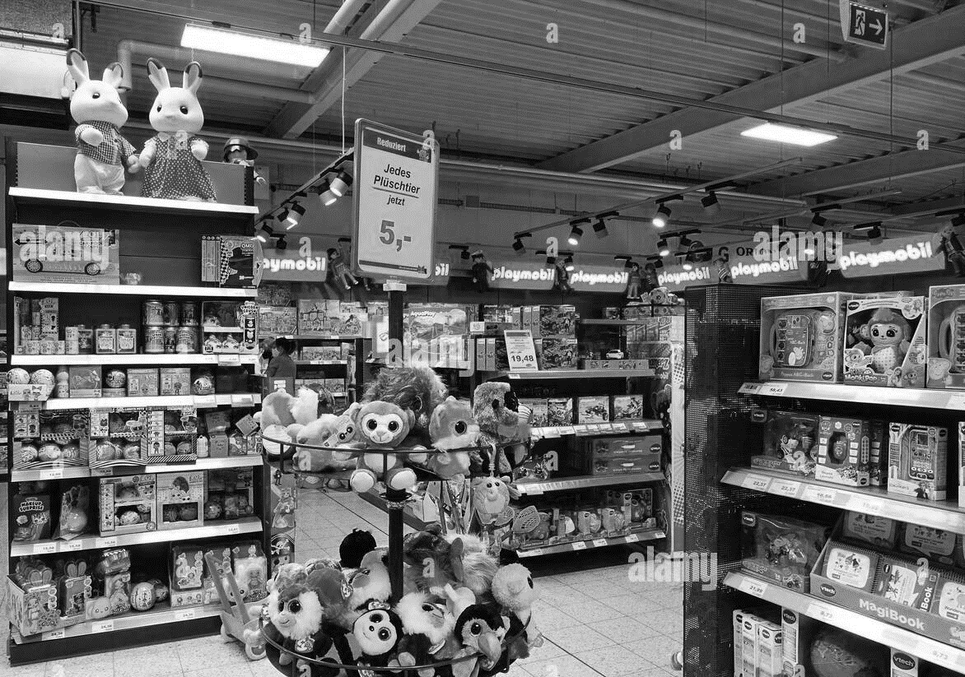
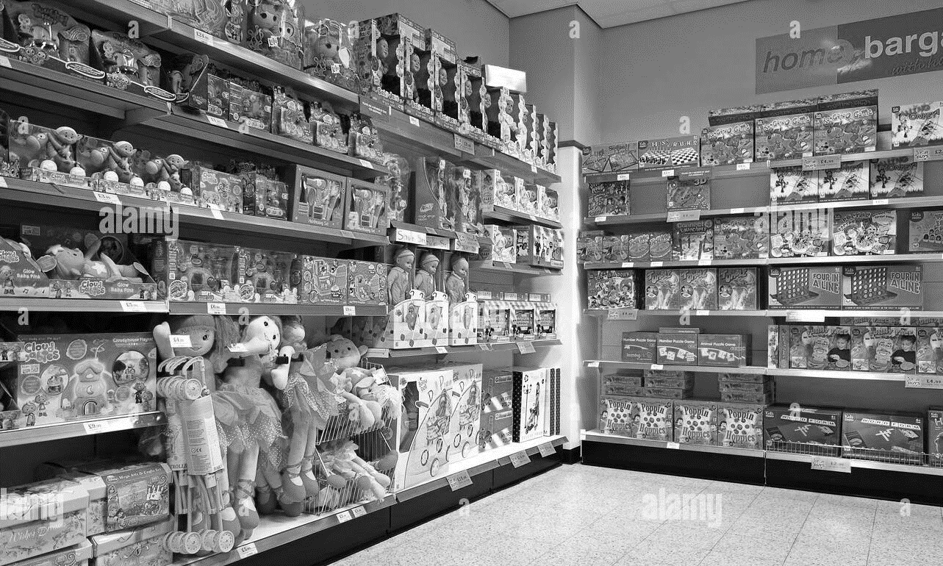
Maven Toys Store Analysis
DIVISION OF QUESTIONS
Queries include:
SELECT, GROUP, ORDER BY,
EASY
MODERATE

Slide 4
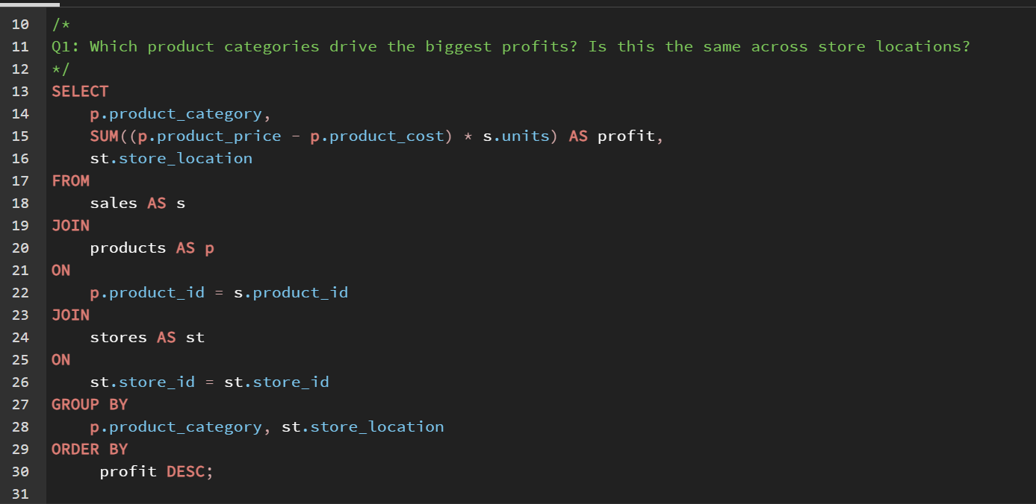
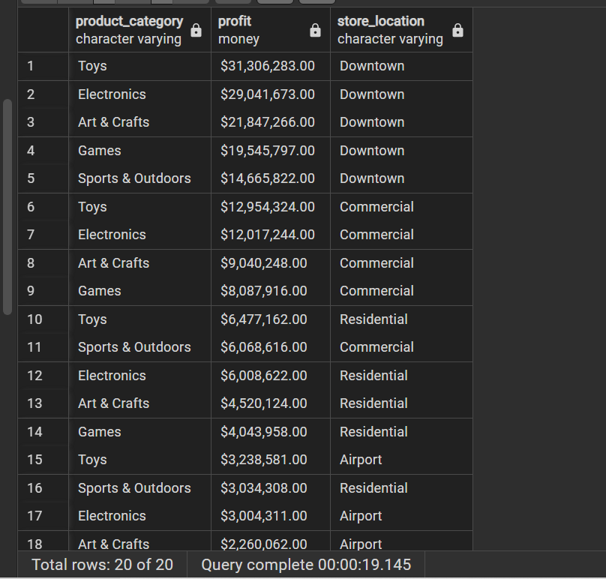
EASY QUESTION 1
Which product categories drive the biggest profits? Is this the same across store locations?

Slide 5
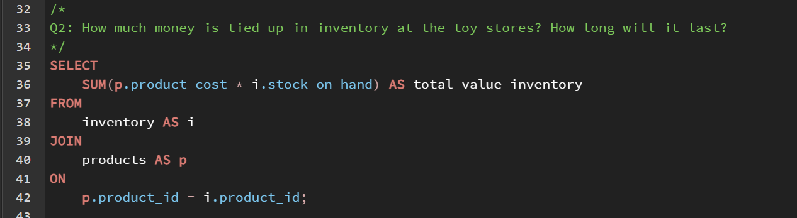
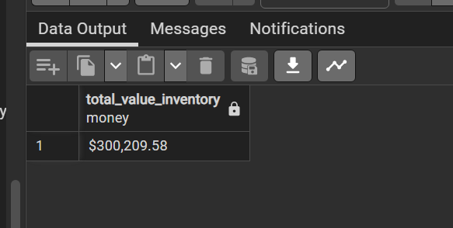
EASY QUESTION 2
How much money is tied up in inventory at the toy stores?

Slide 6
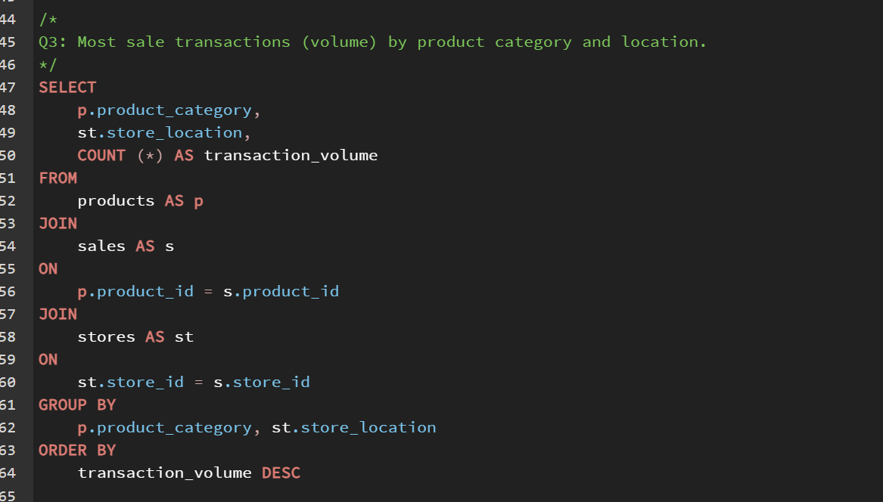
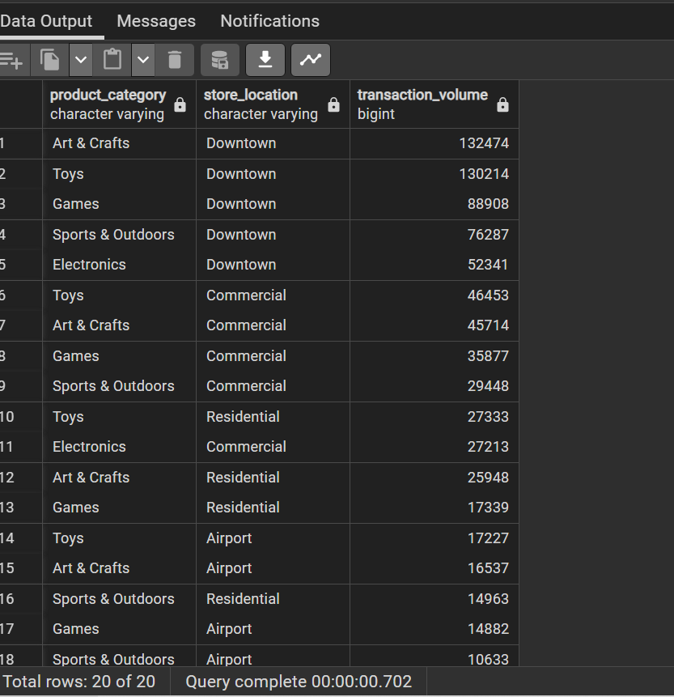
EASY QUESTION 3
Most sale transactions (volume) by product category and location.

Slide 7
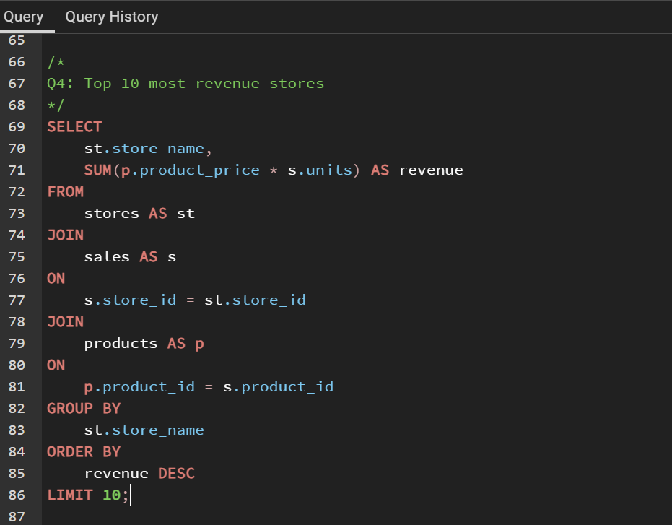
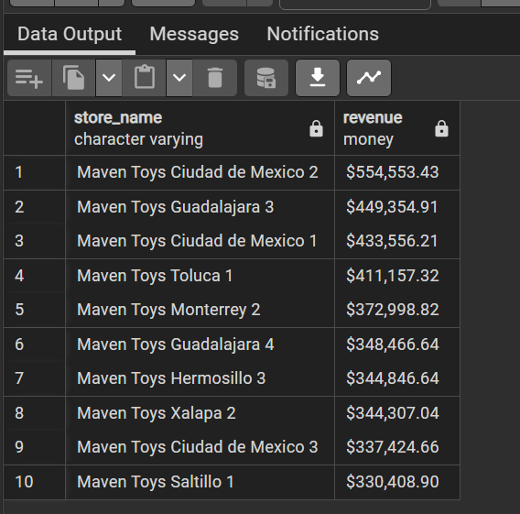
MODERATE QUESTION 1
Top 10 most revenue stores

Slide 8
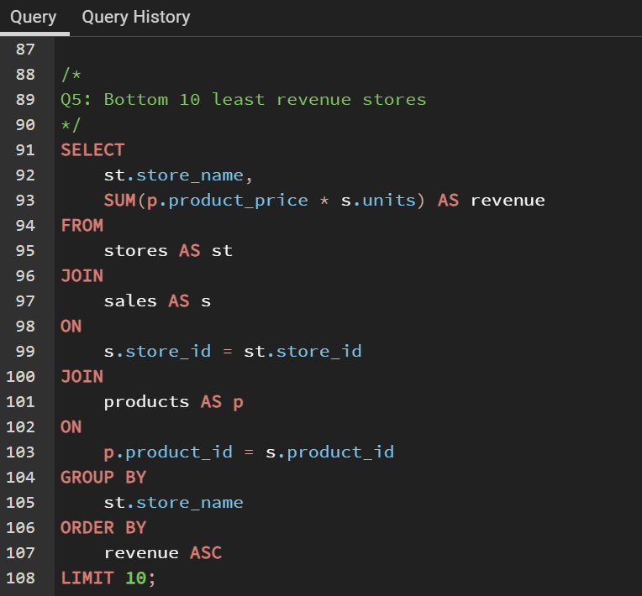
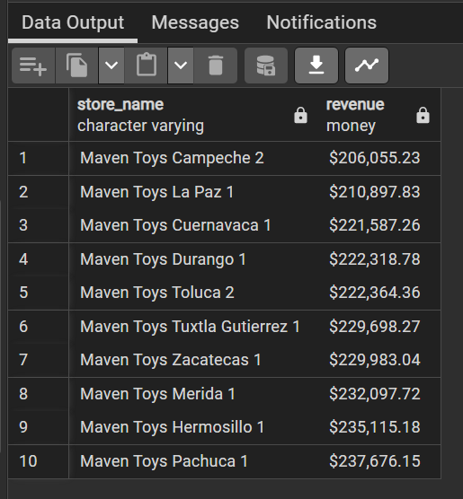
MODERATE QUESTION 2
Bottom 10 least revenue stores

